Slide 1

More Charts Assignment
David Berberena
DSC 640 Data Presentation and Visualization
Weeks 3 and 4
6/30/24

Slide 2
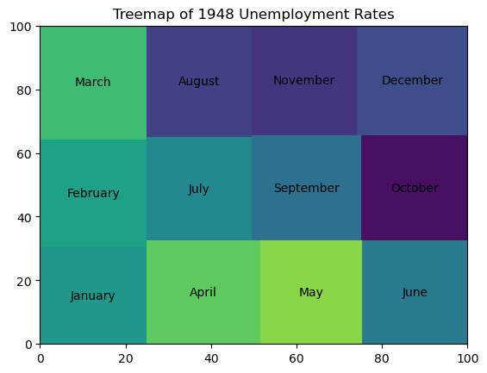
Python Tree Map

Slide 3
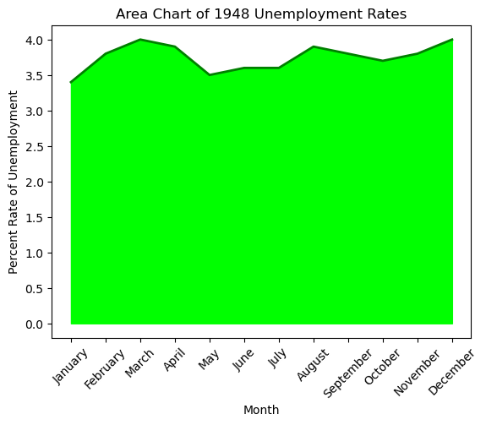
Python Area Chart

Slide 4
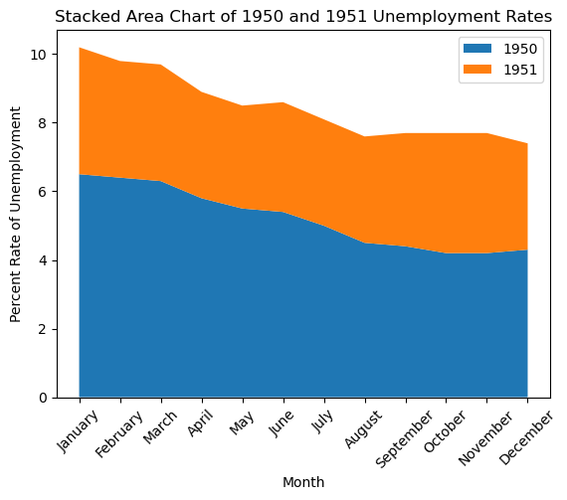
Python Stacked Area Chart

Slide 5
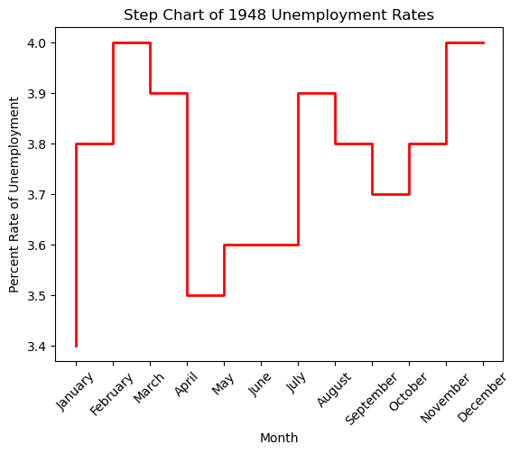
Python Step Chart

Slide 6
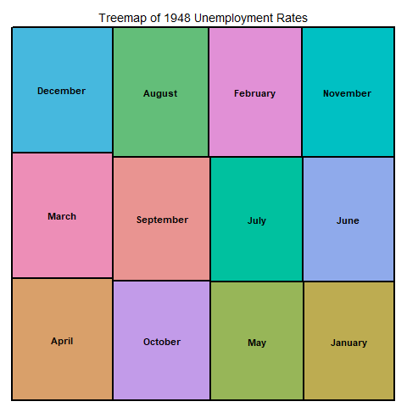
R Tree Map

Slide 7
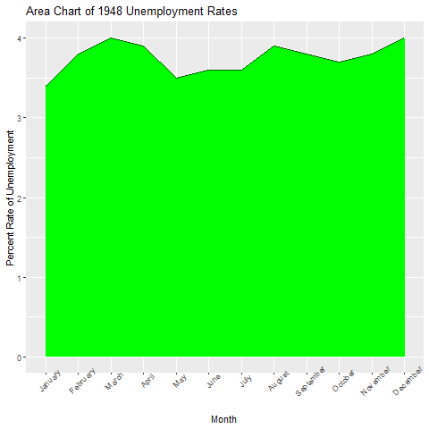
R Area Chart

Slide 8
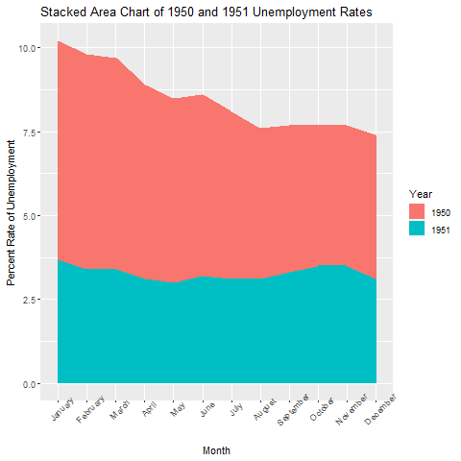
R Stacked Area Chart

Slide 9
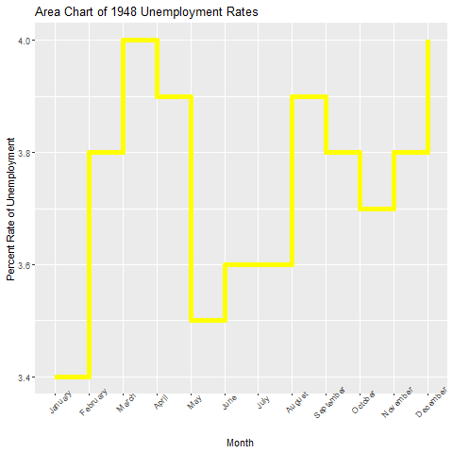
R Step Chart

Slide 10
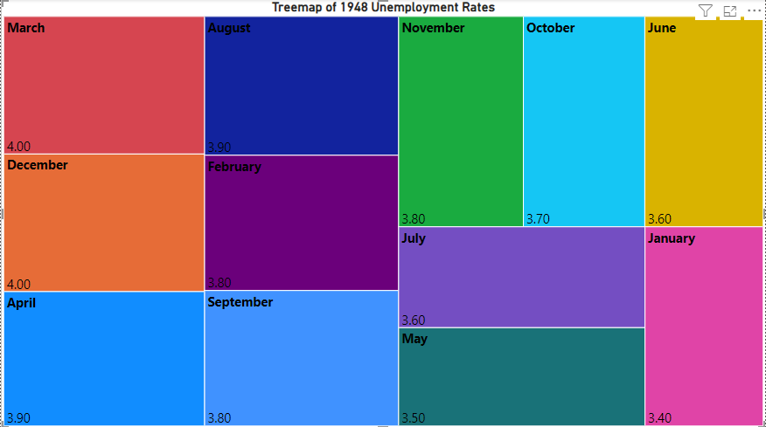
PowerBI Tree Map

Slide 11
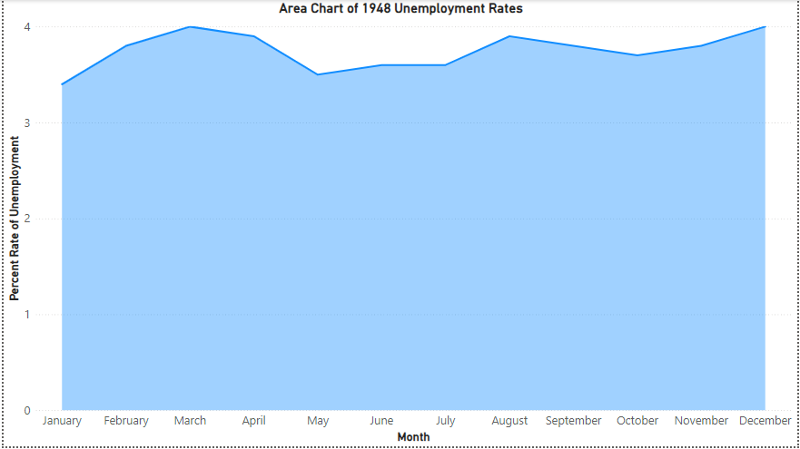
PowerBI Area Chart

Slide 12
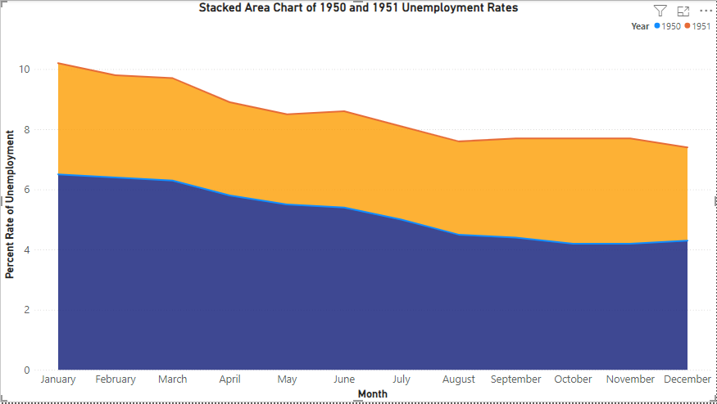
PowerBI Stacked Area Chart

Slide 13
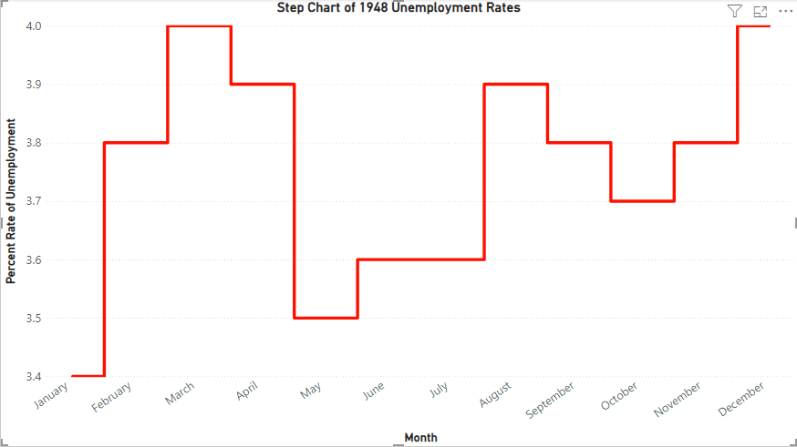
PowerBI Step Chart

